Slide 1
ECO346 | FALL 2026 | SECTION B
1,464
Education spending and the gender literacy gap
students with education spending (ed_total > 0)
5,677
Rural Balochistan, PSLM 2019–20
persons aged 10–64 with literacy recorded
Rs 3,500
Registration no. FA24-BEDS-022
Variant 6 (22 = 2 × 8 + 6) → Balochistan, rural
weighted median annual spend per student
Notes:
Variant 6: Balochistan, rural, from the last two digits of my registration number (22 = 2 x 8 + 6). Two questions: how much do households spend on each student's education, and how does literacy change with age for women and men. Source is the PSLM 2019-20 person file merged with the household file; every statistic is weighted by hhweight.

Slide 2
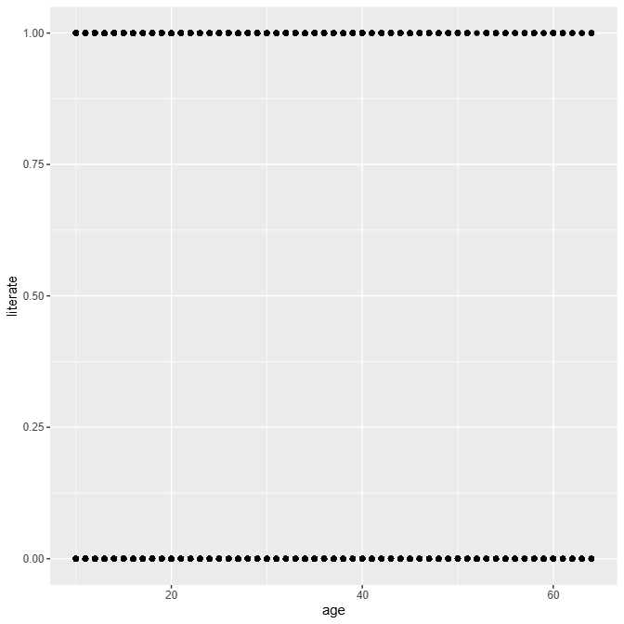
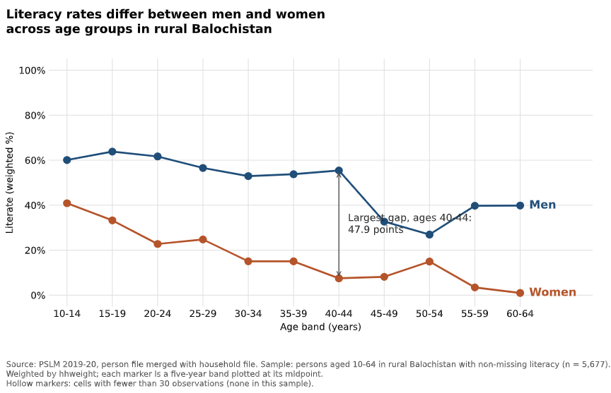
The makeover: from an unreadable cloud of dots to a clear comparison
BEFORE · R default
AFTER · redesign
Individual 0/1 points overplot; no sex comparison is possible.
Conditional means by sex, five-year bands, direct labels, gap annotated.
Trade-off: the redesign no longer shows every individual observation.
Notes:
Left is R's default geom_point of literate against age: only values 0 and 1, so the dots pile on top of each other and tell us nothing about women versus men. The redesign plots weighted conditional means for five-year age bands, one series per sex, labelled directly with no legend, and annotates the largest gap. What the default shows that the redesign hides: the individual observations and the raw 0/1 nature of the outcome.

Slide 3
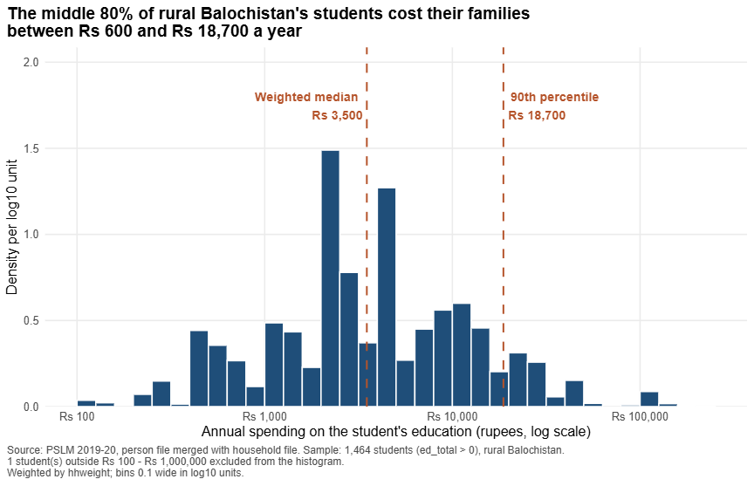
Spending per student varies widely: the middle 80% fall between Rs 600 and Rs 18,700
Rs 3,500
weighted median
unweighted: Rs 3,000
31.17×
90th ÷ 10th percentile
Rs 18,700 vs Rs 600
1,464
students
1 excluded from histogram
Weighted vs unweighted median differ because weights count how many households each student represents.
Notes:
Weighted histogram on a log10 scale, bins 0.1 wide from 2.0 to 6.0, density per log10 unit. Weighted median Rs 3,500 versus unweighted Rs 3,000: the weights give more voice to students in households that represent more of the population, so the two differ. The 90th percentile is Rs 18,700 and the 10th is Rs 600, a ratio of 31.17. One student fell outside the plotted range.

Slide 4
Most important finding: women trail men in every age band, by up to 47.9 points at ages 40–44
Literacy gap, men minus women (percentage points)
Ages 15–19
33.3%
63.8%
women
men
Ages 55–59
3.5%
39.7%
women
men
Descriptive only: this cannot show why the gap exists or that age itself causes it.
Notes:
Weighted literacy rates, rural Balochistan, persons 10-64 (n = 5,677). Women 15-19: 33.3% vs men 63.8%. Women 55-59: 3.5% vs men 39.7%. The largest gap is the 40-44 band at 47.9 points. This is descriptive: it cannot tell us the causes of the gap, and because it is a cross-section, differences across age bands mix generations with age.

